Slide 1


INCOME INSECURITY – A COMMON BATTLE
Stories from Legends and Lessons for Us

Slide 2
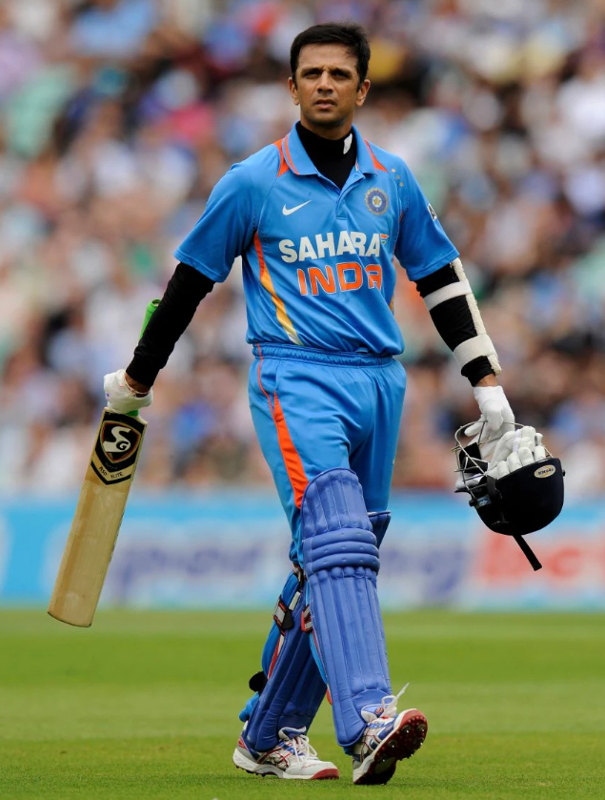
RAHUL DRAVID – DOUBTS DESPITE STARDOM
“When I was dropped from the ODI team in 1998, I felt insecure… I wondered if I was really good enough to play ODIs.”

Slide 3
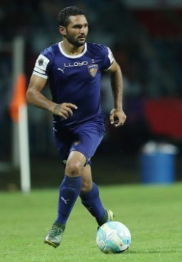
BALJEET SINGH SAHNI – QUITTING AT 31
“In 2019 I moved to Canada. I wasn’t getting paid enough… I had to run the house, have family responsibilities. So I quit football at the age of 31.”

Slide 4
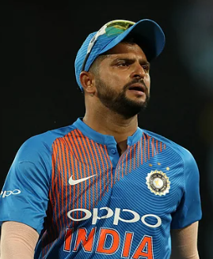
SURESH RAINA – INJURED AND STRESSED
“Was stressed about financial position…”
(After a 6-month bedridden phase due to a knee injury in 2007)

Slide 5
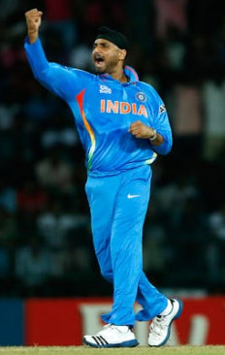
HARBHAJAN SINGH – NO SALARY CERTAINTY
“Imagine… one year I will get ₹ One lakh, the next year nothing… how do we plan our annual income?”
– Letter to Anil Kumble, 2019

Slide 6
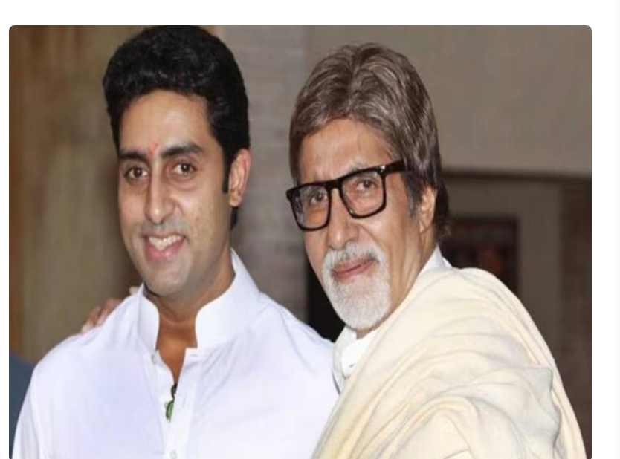
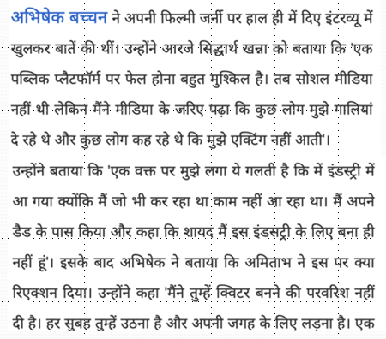

Slide 7
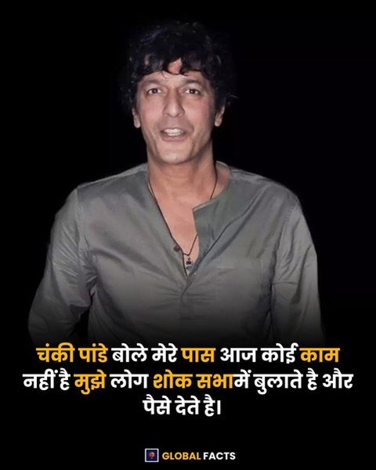

Slide 8
THE INDIAN REALITY
77% of Indians earn less than ₹25,000/month.
Most Indians are not financially secure — it's a harsh truth.

Slide 9
COMMON MAN’S FEAR
“The work is mine, the time is mine, but security is at someone else’s mercy.”

Slide 10
WHAT CAN YOU GIVE YOUR CHILDREN?
“You can give your children not just money, but a system.”
Build systems, not just savings.

Slide 11
THE NEED FOR FINANCIAL SYSTEMS
- Build passive income
- Create security through skills & networks
- Invest in financial literacy

Slide 12
Thank You
“Let’s not just survive – let’s secure.”
Build a future where your income isn’t someone else's decision.

